Slide 1
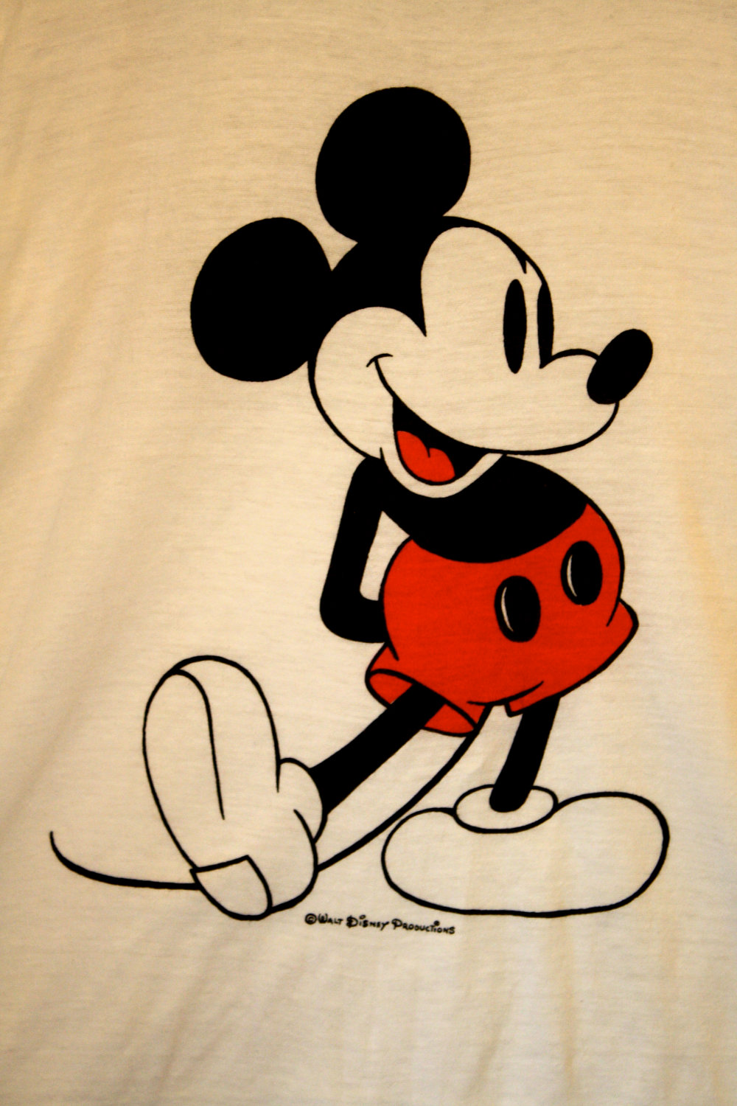
Quiz on Disney’s characters
By Aayan

Slide 2
Who is it?
Is it …
A: Doc
B: Pocahontas
C: Sneezy

Slide 3
Well done Continue Test

Slide 4
Try again
Continue Quiz

Slide 5
Who is it ?
Is it …
A: Mushu
B: Goofy
C: Scrooch

Slide 6
Well done Continue Test

Slide 7
Try again
Continue Quiz

Slide 8
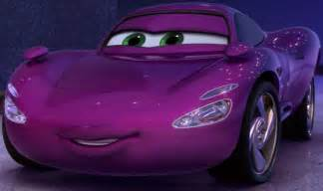
Who is it ?
Is it …
A: Holly
B: Mulan
C: Mowgli

Slide 9
Well done Continue Test

Slide 10
Try again
Continue Quiz

Slide 11
Who is it?
Is it …
A: Fin
B: Timothy Q M
C: Dumbo

Slide 12
Well done Continue Test

Slide 13
Try again
Continue Quiz

Slide 14
Who is it ?
Is it…
A: Dory
B: Mr Stork
C: Bailey

Slide 15
Well done Continue Test

Slide 16
Try again
Continue Quiz

Slide 17
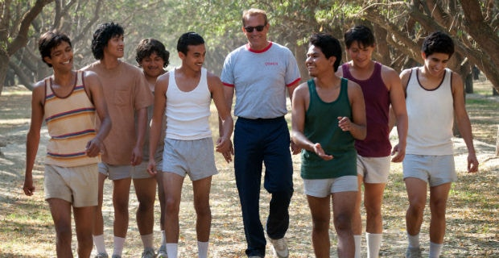
Who is it?
I am a Cross Country coach. My role was played by Kevin Costner in a movie ‘McFarland, USA’. Who am I ?
Is It…
A: Tow Mater
B: Jim Wite
C: Dusty Crop hopper

Slide 18
Well done Continue Test

Slide 19
Try again
Continue Test

Slide 20
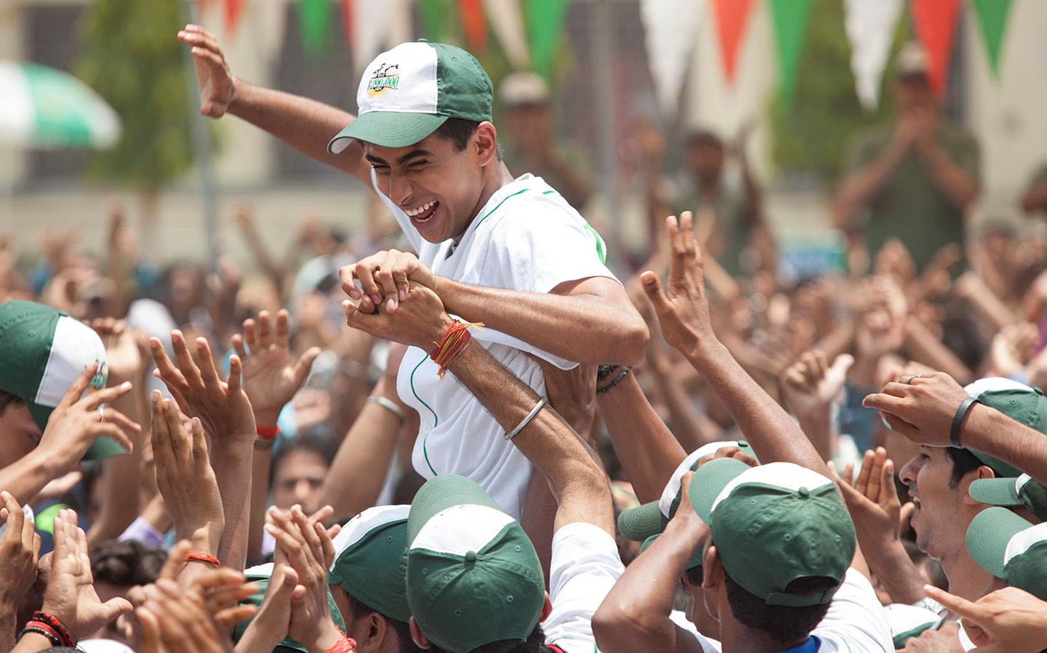
Who is it?
I am a professional baseball pitcher. My role was played by Suraj Sharma in the movie ‘Million Dollar Arm’. Who am I?
Is It …
A: Riku
B: Coach Wite
C: Madhur

Slide 21
Well done

Slide 22
Try again

Slide 23
Thanks For Playing!

