Slide 1
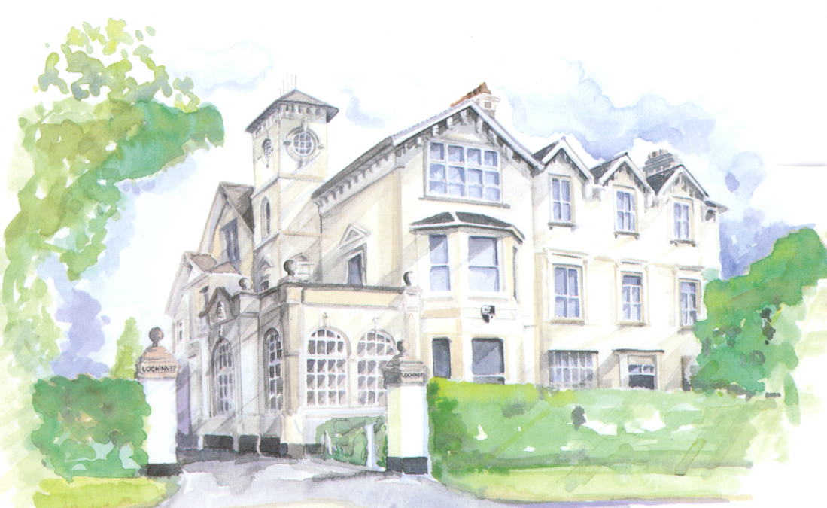
Lochinver House School
An Introduction to Year 4

Slide 2
Take Ownership of your Learning and Responsibility for your Actions.

Slide 3
Year 4 Team
Louise Martin
Julia Chronias
Debbie Fort
Becky Whinnett

Slide 4
Role of team
Main class teachers for literacy, mathematics, class science, history, geography, RE, and PSHE
Pastoral care and registration
First point of contact for boys and parents

Slide 5
Year 4 changes
Along with subject teachers for lab science, music, French, IT, drama, art, games and PE boys will ALSO have Swimming, DT and Mythology.
Games lesson every Thursday 3:35-4:45
Boys develop more independence:
changing for games/swimming
organising their own work space, equipment
and book bags
going to lessons unaccompanied

Slide 6
Organisation
Planners, equipment and book bags to be brought to school every day
Organising school things at home for the next day:
PE / games kit/ swimming kit
Book bag, reading book and homework
Arriving promptly for school:
Boys come into the Year 4 area unaccompanied when the second bell goes at 8.25am. Boys go to Breakfast Club if they arrive before 8.25. The register is closed at 8.35. Late arrivals should come in as soon as they arrive, parents to inform the office

Slide 7
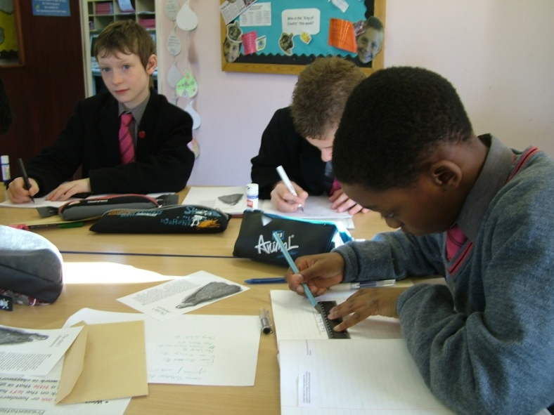
Pencil Cases
Fully equipped
pencil cases: Equipment must be
labelled permanently.
Lots of good quality pencils
A pencil sharpener
A rubber
A 30 cm ruler (not flexible or folding)
Colouring pencils and felt-tips
A glue stick and scissors
A small selection of gel pens
Check regularly with your son to see if anything needs replacing

Slide 8
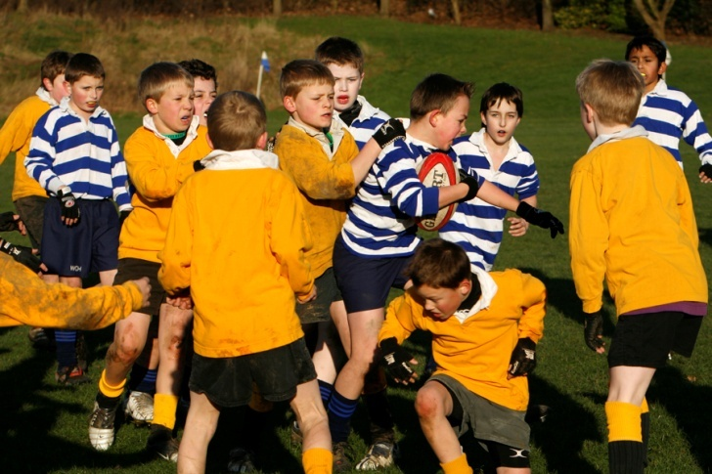
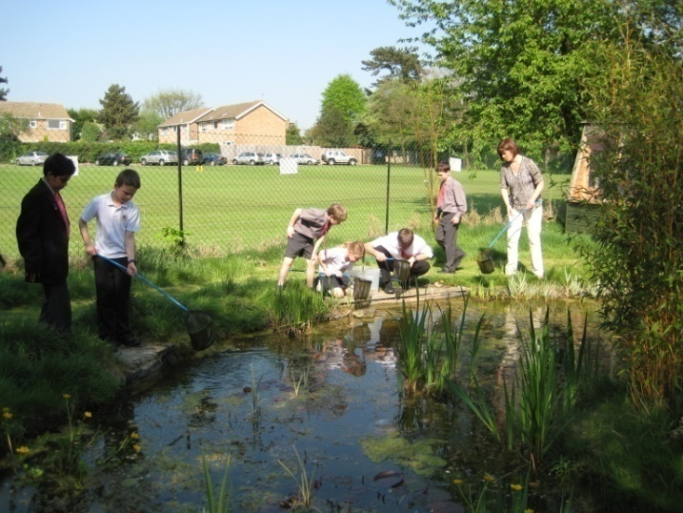
Senior Sports Kit
A list of the kit the boys will need is in the uniform section of the Parents’ Handbook: please refer to this for details.
Please make sure all kit is named.
Summary of sports kit:
Swimming kit: trunks, towel, goggles (if needed)
PE and Games kit: same as Year 3 plus football boots and shin pads. There will be a mouthguard fitting session later in the first term.

Slide 9
Reading
Please try to listen to your son read every night.
It is important that your son is reading for
pleasure and enjoyment: with help from Mrs
Whinnett and Mrs Fort, he will choose his own school reader
from the levels in our library – but, in addition,
he can read any other books or publications
that interest him.
He should read for at least 15 minutes a night: the page number should be recorded on his book mark, and the book brought in every day .
He will also be heard reading at school: the number of times a week will depend on his current fluency.

Slide 10
Homework
15 minutes of reading everyday
Plus Monday = English
Wednesday = Maths
Friday = Humanities/Science
Spellings

Slide 11
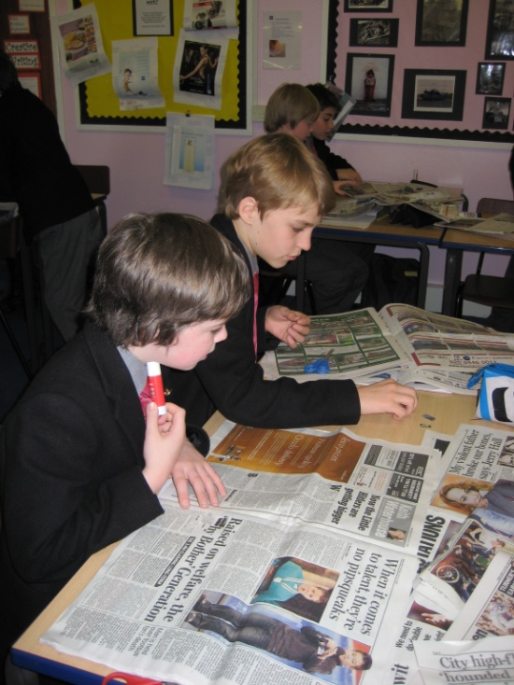
Rewards and Sanctions
in Year 4
HOUSES and the CREDIT SYSTEM
Earning credits for their house
School teams
Personal recognition and encouragement
Chocolate break and awards
Praise on a Postcard
DEBITS
Debits in the Senior School
Loss of Tuck
Blue Room break time detention
Referral to Senior Leadership Team

Slide 12
Supporting your son in Year 4
Please name every item of your son’s uniform and sports kit: they change in the sports changing room for games and any unclaimed items are automatically put in Lost Property.
Help him to develop simple, consistent routines for completing homework and packing the correct school things for the next day: this will set him up for life!
Regularly check that his pencil case and sports kit is complete, to enable him to function fully in class.
Take time to discuss his day and listen to him read each evening.
If you have any concerns, please do not hesitate to contact us by email in the first instance so that we can address anything quickly.

Slide 13
Welcome to Year 4
Perstare Praestare
To Persevere is to Succeed
If you would like a copy of this presentation
please email us with your request

