Slide 1
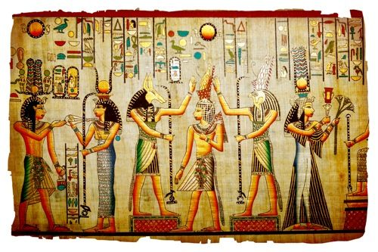
All about the Egyptian by Kaylan Pabari

Slide 2
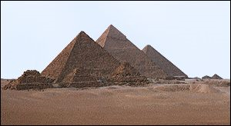
The pyramids
 | The ancient Egyptians built pyramids as tombs for the Pharaohs and their queens. The pharaohs were buried in pyramids of many different shapes and sizes from before the beginning of the Old Kingdom to the end of the Middle Kingdom.
There are about eighty pyramids known today from ancient Egypt. The three largest and best-preserved of these were built at Giza at the beginning of the Old Kingdom. The most well-known of these pyramids was built for the pharaoh Khufu. It is known as the 'Great Pyramid'.

Slide 3
Egyptian cats
The ancient Egyptians had many pets. Some homes kept crocodiles as pets. But most people preferred birds or dogs as pets.
Nearly all homes had a cat. Cats caught rats and snakes and mice. But that was just a bonus. The ancient Egyptians did not worship cats, but they did believe that cats had magical powers. They believed cats guarded their children and their homes. It was against the law in ancient Egypt to harm a cat. If you killed a cat, the punishment could be death.
The ancient Egyptians used cats in their art and sculptures. When they did, cats were always pictured or positioned with respect.
The ancient Egyptian goddess Bastet had the head of a cat and the body of a woman. To the ancient Egyptians, Bastet was a protective, gentle goddess.
In ancient Egypt, cats were important.

Slide 4
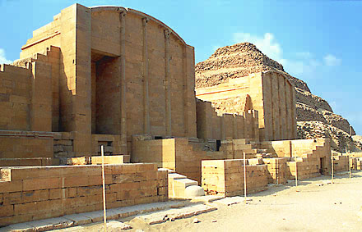
Egyptian houses
Poor people had homes that were usually one row of bricks, but the wealthier people often had two and even three rows of bricks. The mud bricks were cheap to make, but they found out that in a couple of years, they started to crumble. The very richest people had enough money to have homes made out of stone and also had granite stone gateways.

Slide 5
Egyptian gods
God of |  |  | Name |  |  | Appearance
Earth |  |  | Geb |  |  | colour of plants and Nile mud
Dead |  |  | Osiris |  |  | Dressed in white with crook and fail
Desert |  |  | Seth |  |  | Animal head with long curved snout
Pharaoh |  |  | Horus |  |  | Head of hawk and crown of egypt

